Slide 1
Computer Operating Systems
Week 01 – Unit Introduction

Slide 2
Unit Outcomes
This is a 2-credit unit that will be delivered over 35 weeks (3 blocks)
Outcome 1:
Analyse suitability of operating systems for an environment
Outcome 2:
Configure an Operating System for use within an environment

Slide 3
Assessments
There are 3 assessments to be completed to achieve this unit.
1 extended response assessment
2 practical tasks recorded via screen recording software

Slide 4
** Outcome 3 **
Outcome 3 : Automate common tasks of computer operating systems using scripting, covers a number of topics that are repeated further into your course.
Due to this, Outcome 3 of Computer Operating systems, has been mapped with the unit Scripting for Security.
There will be no assessment for this outcome in block 1, this will take place in block 3 with the one assessment covering outcomes within both units

Slide 5
What Is An Operating System?
An Operating System carries out several tasks, however, it’s main function is to provide an interface between the user and the systems hardware.
This allows the user to interact with the system.
The applications that we use to carry out everyday tasks such as word processing and email, are unable to directly communicate with system hardware on their own.

Slide 6
What Is An Operating System?
The Operating Systems allows the execution of these applications as well as additional tasks such as memory management and input/output tasks.
Irrespective of the system or device, an operating system or software, is required in order for it to function and carry out its specified tasks.

Slide 7
Operating System Features
Although providing an interface between user and hardware is the main function of any Operating System, there are also a number of additional functions that are also carried out by an Operating System:
Disk Access
Network Security
Application Execution
Access and Manipulation of the File System
Resource Allocation
Error Detection
Memory Management

Slide 8
Operating Systems
There are a number of different Operating Systems available today. Some carry out all of the previous features and more; some carry out a limited number of them.
The reason behind the variety of Operating Systems available is due to the hardware.
In the beginning, because the Operating System required to give instructions to the systems hardware in order for it to function, each hardware manufacturer had to have an OS to out these tasks.

Slide 9
Operating Systems
As computers have developed over time, the creators of operating systems have made it possible for certain drivers to be installed on the system in order to allow the operating system to be compatible with almost all hardware.
Which one you use will largely depend on the system you are using as well as the environment and tasks that you wish to use it for.

Slide 10
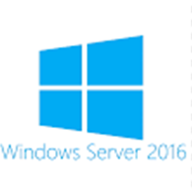
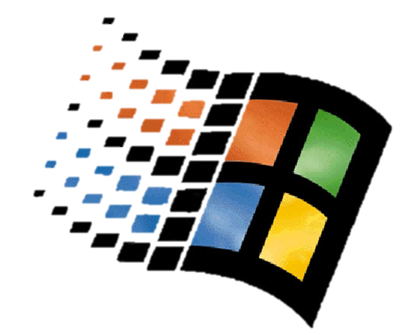
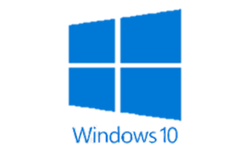
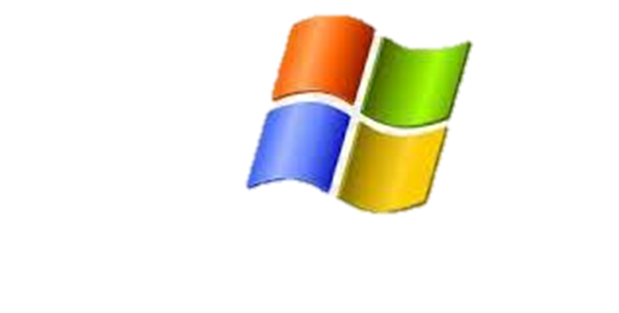
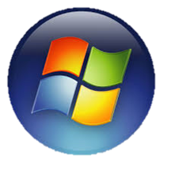
Common Operating Systems …..
Windows 95
Windows 7
Windows Vista
Windows

Slide 11
Microsoft Windows
Windows systems are one of the most common and recognisable Operating Systems that are available today.
Due to the compatibility with the extensive range of Microsoft desktop applications, as well as their usability, Windows has become a popular Operating System used by over 1.5 billion users worldwide.
Over the years, Windows has developed and updated multiple Operating Systems for desktop, server and mobile .

Slide 12






Common Operating Systems …..
Fedora
Debian
Kali Linux
Linux
Ubuntu
Centos

Slide 13
Linux
Linux is a collection of operating systems based on the Unix Kernel.
There are multiple distributions of Linux, and which one you use is generally dependant on the purpose of the system.
For Example:
The extensive range of security tools that come readily available with Kali Linux makes it a suited OS for security professionals to use.
Ubuntu on the other hand is suited for desktop use by individual users due to its user-friendly interface

Slide 14
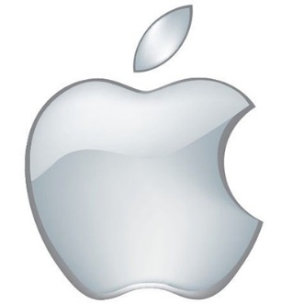

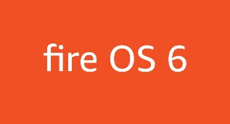
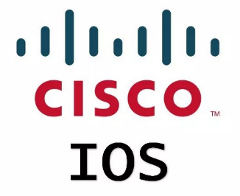
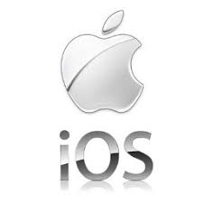
Other Operating Systems

Slide 15
Other Operating Systems
Although Windows and Linux distributions are 2 of the most commonly used systems for desktop devices, there are others available.
For example, Apples MacOS is fairly popular with those who favour Apple products. As is the mobile version IOS which is used by Apples mobile devices such as Iphones and Ipads.
Other popular mobile device Operating Systems include Android and Amazon Fire OS.

Slide 16
Other Operating Systems
The previously mentioned systems are fairly common, and as they are used by devices that most of us interact with on daily basis, we are aware that they exist.
It is common knowledge that out PCs and mobile phones require some sort of OS to allow the hardware to carry out its intended functions.
What may not be as apparent is that every device needs some sort of OS. Cisco routers for example, use Ciscos IOS. Other devices such as ATMs and games consoles also require Operating Systems.

Slide 17
Operating Systems
Over the course of this unit, we will be looking at a range of Operating Systems.
These will include:
Single User Systems
Multi User Systems
Embedded Systems
Mobile Operating Systems

Slide 18
Operating Systems
We will also be looking at the different environments that operating systems offer, such as the command line and graphical user interface.
Additionally, we will be looking at the file systems that are used by some systems, and how these allow us to store and retrieve data.
File systems that we will look at will include, FAT, NTFS and Ext.

Slide 19
For Next Week ……
There is no tutorial this week
Slides are available to access on Moodle

